Slide 1
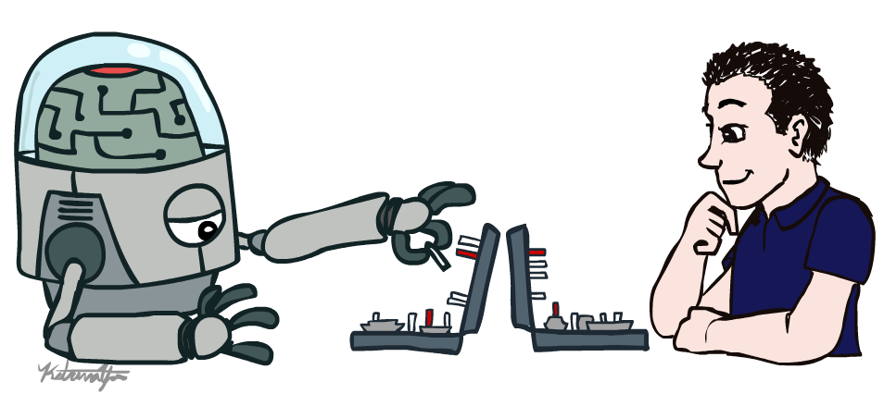
CAP 5636 – Advanced Artificial Intelligence
History and positioning
Instructor: Lotzi Bölöni
  [These slides were adapted from the ones created by Dan Klein and Pieter Abbeel for CS188 Intro to AI at UC Berkeley, available at http://ai.berkeley.edu.]
Notes:
Please retain proper attribution, including the reference to ai.berkeley.edu. Thanks!

Slide 2
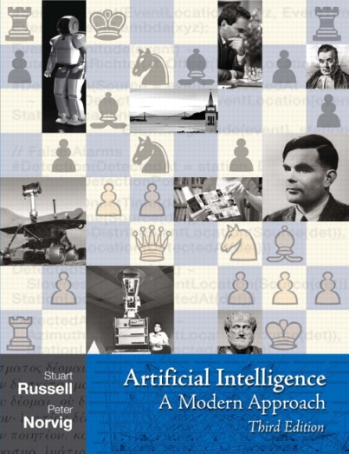
Textbook
Not required, but for students who want to read more we recommend
  Russell & Norvig, AI: A Modern Approach, 3rd Ed.
  Warning: Not a course textbook, so our presentation does not necessarily follow the presentation in the book.

Slide 3
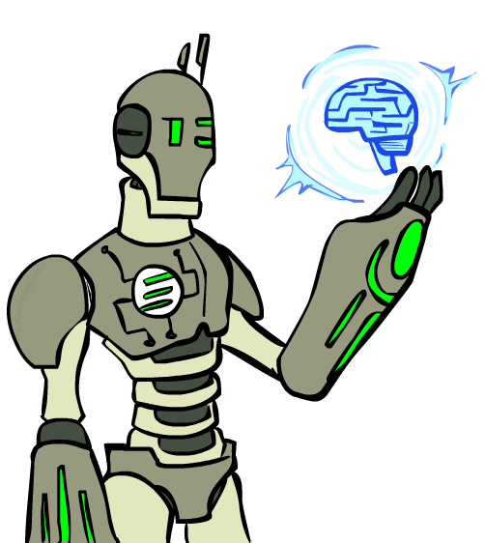
Today
What is artificial intelligence?
What can AI do?
What is this course?

Slide 4
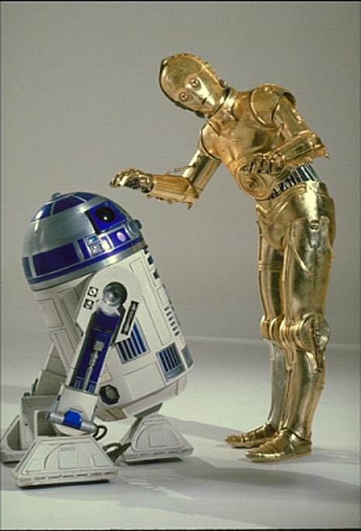
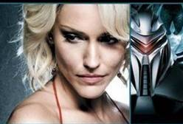
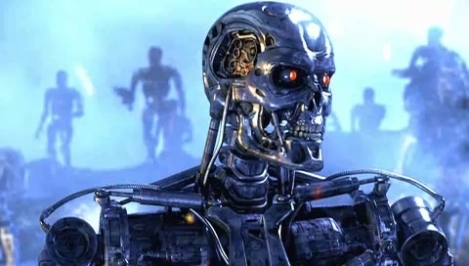
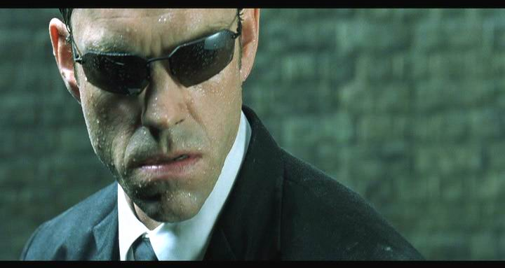
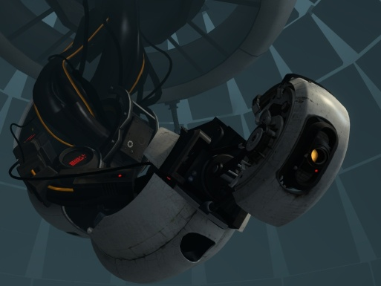
Sci-Fi AI?
Notes:
Who are these? C3PO, what does he do? Essentially google translate, (but with anxiety disorder!)
Small guy? R2D2 – what does he do, yeah, not so sure
Things got darker: machines come back from the future – to kill us!
90’s : software is scary
Basic fear about what technology might do ?
What if we can’t even tell technology apart from ourselves?
OR maybe it’ll look really different and snarky
Some exceptions like wall-E, positive view of technology (but maybe not of us humans!)
But mostly a worry [not very worried myself, at least at present]

Slide 5
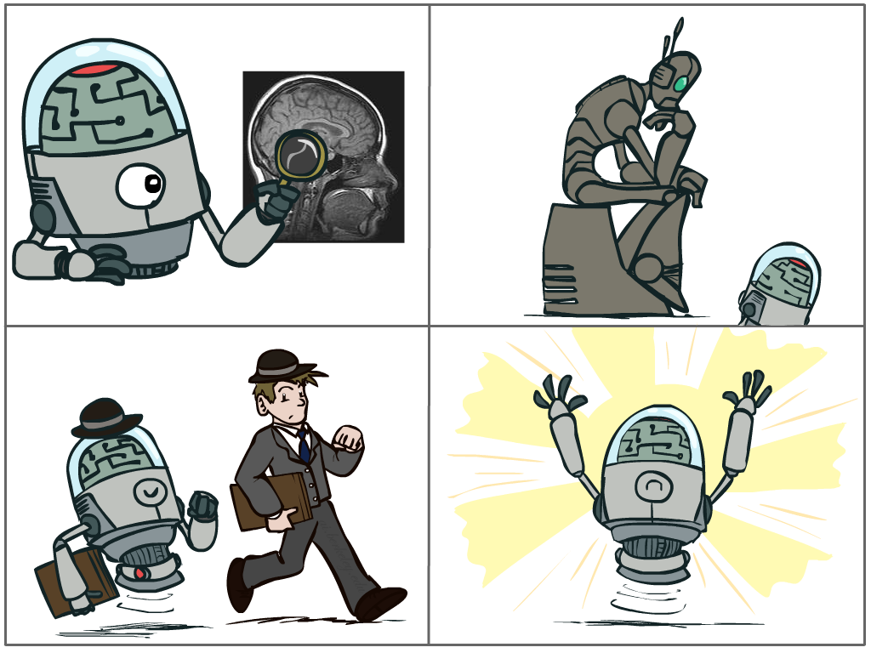
What is AI?
The science of making machines that:
Think like people
Think rationally
Act like people
Act rationally
Notes:
Top left: Think like people --- cognitive science, neuroscience
Bottom left: act like people --- actually very early definition, dating back to Alan Turing --- Turing test; problem to do really well you start focusing on things like don’t answer too quickly what the square root of 1412 is, don’t spell too well, and make sure you have a favorite movie etc. So it wasn’t really leading us to build intelligence
Think rationally – long tradition dating back to Aristotle --- but not a winner, because difficult to encode how to think, and in the end it’s not about how you think, it’s about how you end up acting

Slide 6
Rational Decisions
We’ll use the term rational in a very specific, technical way:
  Rational: maximally achieving pre-defined goals
  Rationality only concerns what decisions are made
  (not the thought process behind them)
  Goals are expressed in terms of the utility of outcomes
  Being rational means maximizing your expected utility
A better title for this course would be:
Computational Rationality
Notes:
Example of utilities. 10 for A, 1 for each Friday with friends

Slide 7
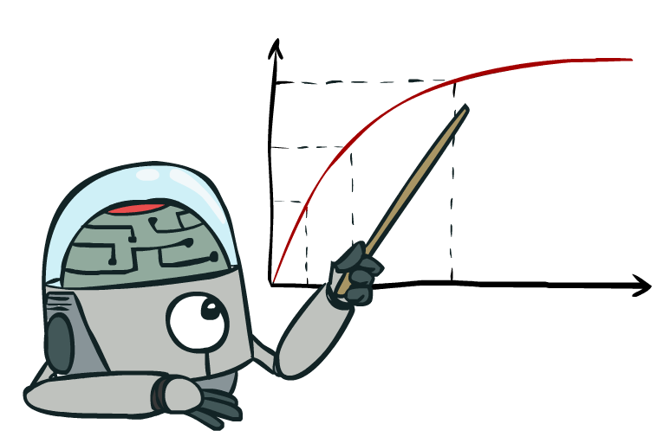
Maximize Your
Expected Utility

Slide 8
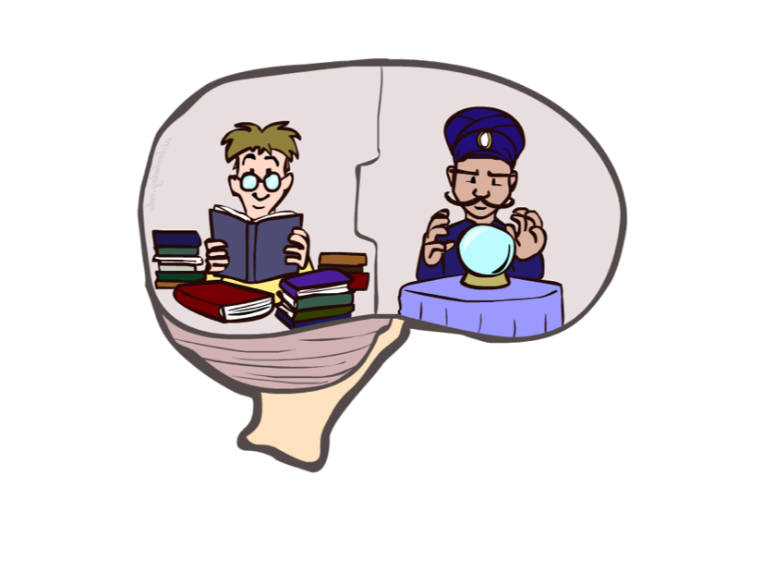
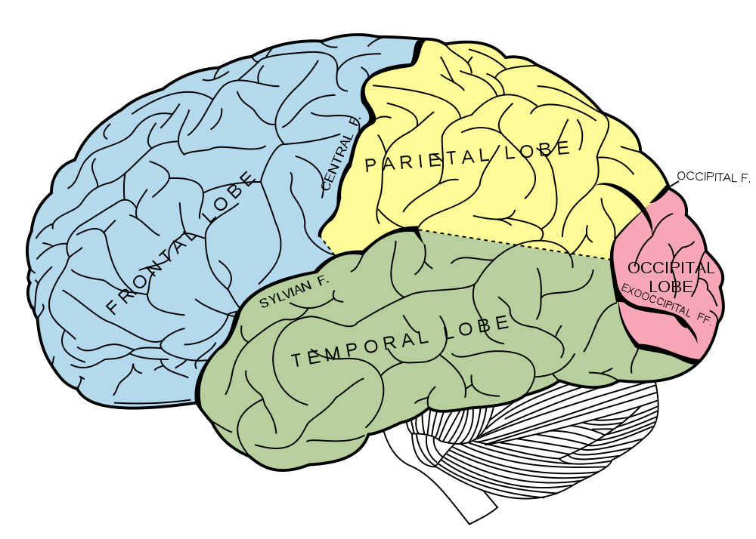
What About the Brain?
Brains (human minds) are very good at making rational decisions, but not perfect
Brains aren’t as modular as software, so hard to reverse engineer!
“Brains are to intelligence as wings are to flight”
Lessons learned from the brain: memory and simulation are key to decision making

Slide 9
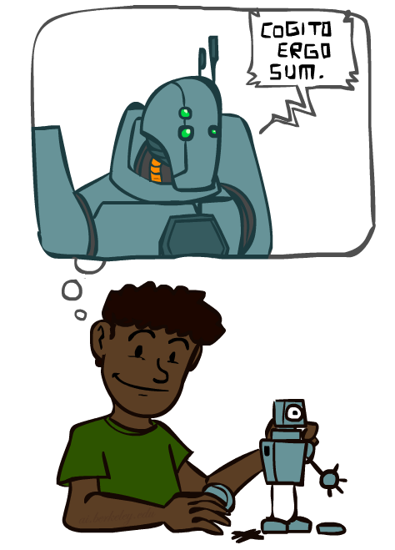
A (Short) History of AI
Demo: HISTORY – MT1950.wmv

Slide 10
A (Short) History of AI
1940-1950: Early days
  1943: McCulloch & Pitts: Boolean circuit model of brain
  1950: Turing's “Computing Machinery and Intelligence”
1950—70: Excitement: Look, Ma, no hands!
  1950s: Early AI programs, including Samuel's checkers program, Newell & Simon's Logic Theorist, Gelernter's Geometry Engine
  1956: Dartmouth meeting: “Artificial Intelligence” adopted
  1965: Robinson's complete algorithm for logical reasoning
1970—90: Knowledge-based approaches
  1969—79: Early development of knowledge-based systems
  1980—88: Expert systems industry booms
  1988—93: Expert systems industry busts: “AI Winter”
1990—: Statistical approaches
  Resurgence of probability, focus on uncertainty
  General increase in technical depth
  Agents and learning systems… “AI Spring”?
2000—: Where are we now?

Slide 11
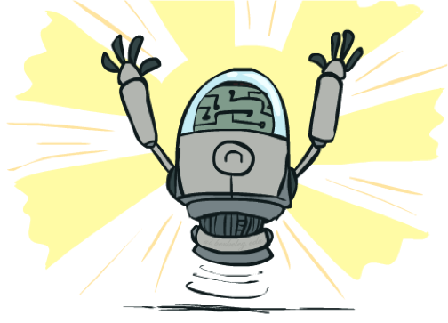
What Can AI Do?
Quiz: Which of the following can be done at present?
Play a decent game of table tennis?
Play a decent game of Jeopardy?
Drive safely along a curving mountain road?
Drive safely along University Blvd?
Buy a week's worth of groceries on the web?
Buy a week's worth of groceries at Publix?
Discover and prove a new mathematical theorem?
Converse successfully with another person for an hour?
Perform a surgical operation?
Put away the dishes and fold the laundry?
Translate spoken Chinese into spoken English in real time?
Write an intentionally funny story?

Slide 12
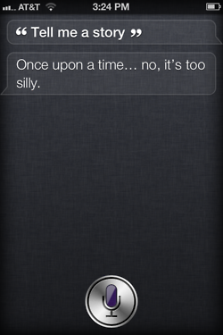
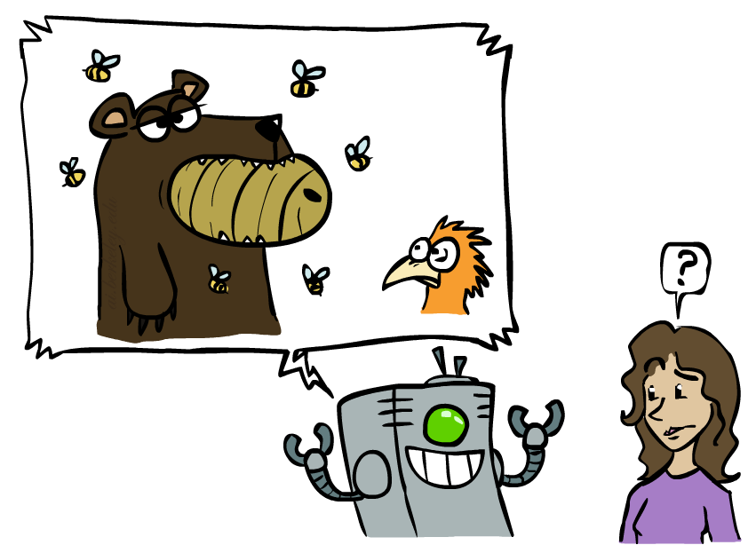
Unintentionally Funny Stories
One day Joe Bear was hungry. He asked his friend
Irving Bird where some honey was. Irving told him
there was a beehive in the oak tree. Joe walked to
the oak tree. He ate the beehive. The End.
Henry Squirrel was thirsty. He walked over to the
river bank where his good friend Bill Bird was sitting.
Henry slipped and fell in the river. Gravity drowned.
The End.
Once upon a time there was a dishonest fox and a vain crow. One day the crow was sitting in his tree, holding a piece of cheese in his mouth. He noticed that he was holding the piece of cheese. He became hungry, and swallowed the cheese. The fox walked over to the crow. The End.
[Shank, Tale-Spin System, 1984]
Notes:
1 – physically wrong, shouldn’t eat beehive
2 – forgot that in drowning not the force is most important but the drownee
3 – not physically wrong, not wrong in a language way, but wrong in the sense that it’s not aware of what is relevant to communicate and what is not
Siri – is that progress?

Slide 13
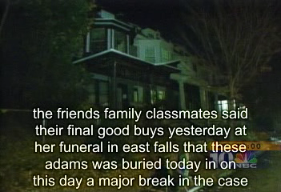
Natural Language
Speech technologies (e.g. Siri)
  Automatic speech recognition (ASR)
  Text-to-speech synthesis (TTS)
  Dialog systems
Demo: NLP – ASR tvsample.avi
Notes:
NLP – ASR tvsample.avi

Slide 14
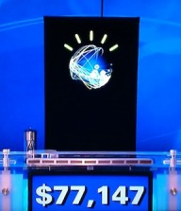
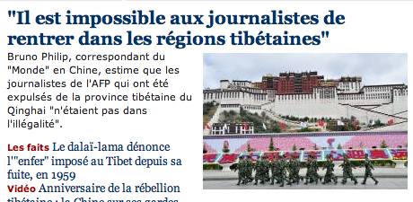
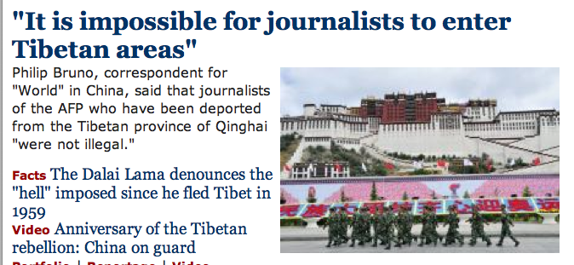
Natural Language
Speech technologies (e.g. Siri)
  Automatic speech recognition (ASR)
  Text-to-speech synthesis (TTS)
  Dialog systems
Language processing technologies
  Question answering
  Machine translation
  Web search
  Text classification, spam filtering, etc…

Slide 15
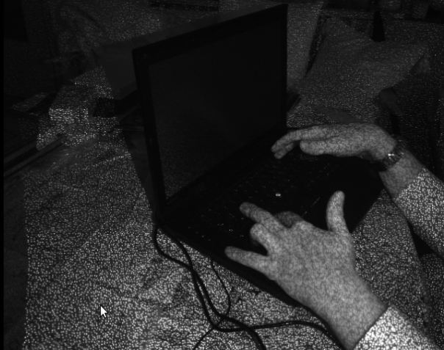
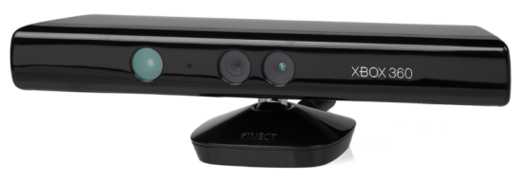
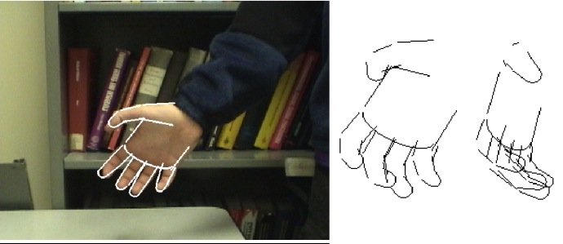
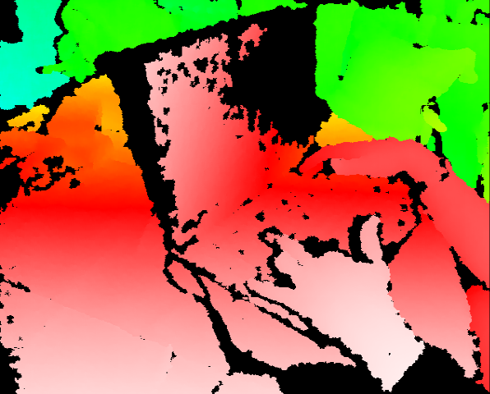
Vision (Perception)
Object and face recognition
Scene segmentation
Image classification
Demo1: VISION – lec_1_t2_video.flv
Images from Erik Sudderth (left), wikipedia (right)
Demo2: VISION – lec_1_obj_rec_0.mpg

Slide 16
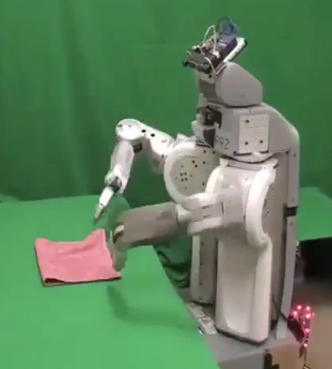
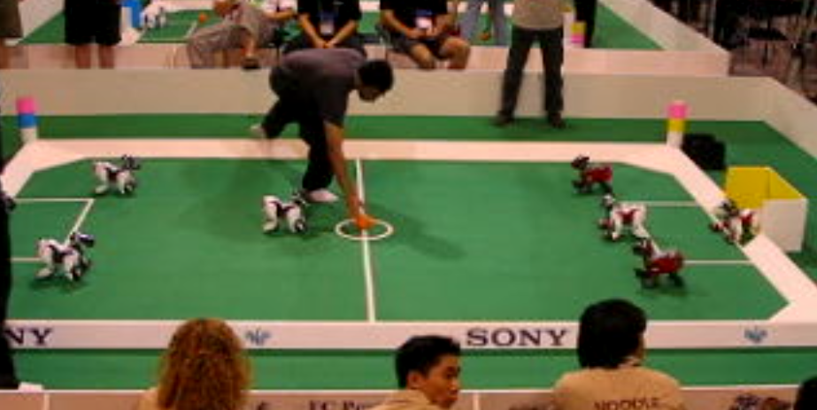
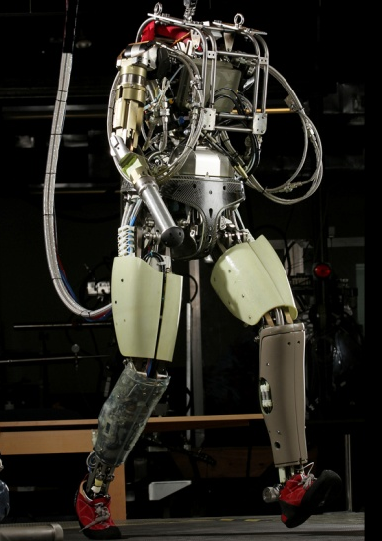
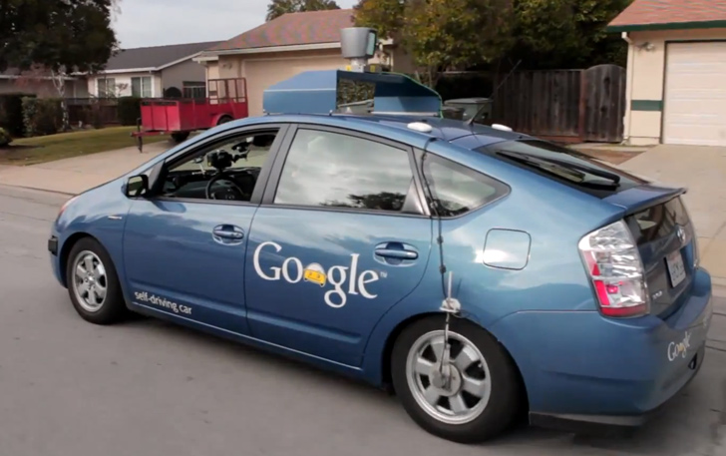
Robotics
Robotics
  Part mech. eng.
  Part AI
  Reality much
  harder than
  simulations!
Technologies
  Vehicles
  Rescue
  Soccer!
  Lots of automation…
In this class:
  We ignore mechanical aspects
  Methods for planning
  Methods for control
Images from UC Berkeley, Boston Dynamics, RoboCup, Google

Slide 17
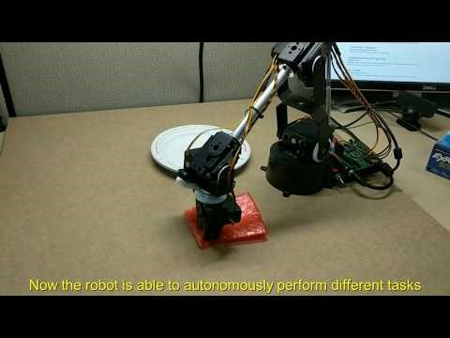
Robot AI (at UCF)

Slide 18
Logic
Logical systems
  Theorem provers
  NASA fault diagnosis
  Question answering
Methods:
  Deduction systems
  Constraint satisfaction
  Satisfiability solvers (huge advances!)
Image from Bart Selman

Slide 19
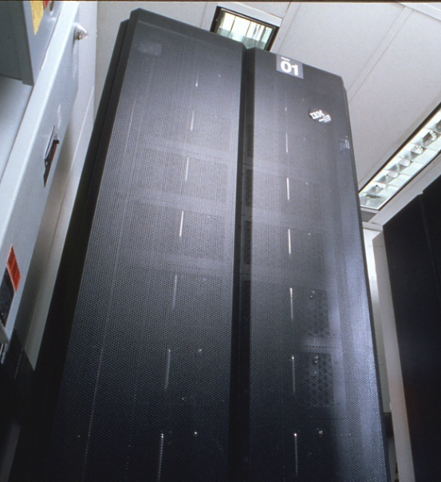
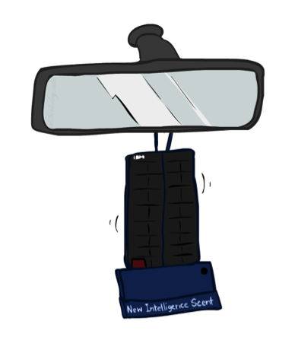
Game Playing
Classic Moment: May, '97: Deep Blue vs. Kasparov
  First match won against world champion
  “Intelligent creative” play
  200 million board positions per second
  Humans understood 99.9 of Deep Blue's moves
  Can do about the same now with a PC cluster
Open question:
  How does human cognition deal with the
  search space explosion of chess?
  Or: how can humans compete with computers at all??
1996: Kasparov Beats Deep Blue
“I could feel --- I could smell --- a new kind of intelligence across the table.”
1997: Deep Blue Beats Kasparov
“Deep Blue hasn't proven anything.”
Huge game-playing advances recently, e.g. in Go!
Text from Bart Selman, image from IBM’s Deep Blue pages
Notes:
Yeah, Kasparov comment probably says more about humans than about computers

Slide 20
Alpha Go
Highest ranked human player, Lee Sedol defeated by Alpha Go (March 2016)
DeepMind
  British “deep learning” startup, bought by Google in 2014 for 500 million dollars
Why is this news?
  Go was considered harder than other games, due to combinatorial explosion.
  Also, some degree of “mystique”
How does it work
  Neural networks bootstrapped from a database of 30 million moves from expert players
  Further improvements through extensive self-play
  For some reason, this is claimed to be “the way humans learn Go”

Slide 21

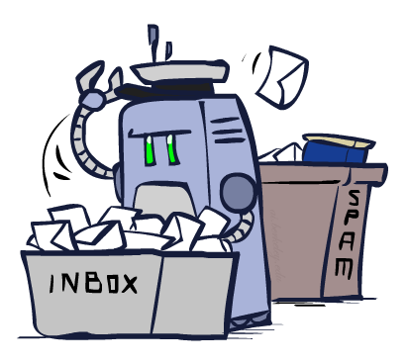
Decision Making
  Applied AI involves many kinds of automation
    Scheduling, e.g. airline routing, military
    Route planning, e.g. Google maps
    Medical diagnosis
    Web search engines
    Spam classifiers
    Automated help desks
    Fraud detection
    Product recommendations
    … Lots more!
Notes:
All applications can be thought of as decision making or useful sub-components of decision making

Slide 22
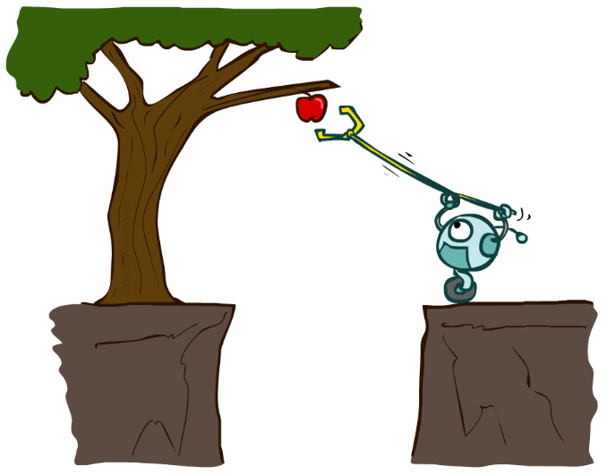
Designing Rational Agents
An agent is an entity that perceives and acts.
A rational agent selects actions that maximize its (expected) utility.
Characteristics of the percepts, environment, and action space dictate techniques for selecting rational actions
This course is about:
  General AI techniques for a variety of problem types
  Learning to recognize when and how a new problem can be solved with an existing technique
Sensors
Agent
Percepts
Environment
?
Actuators
Actions

Slide 23
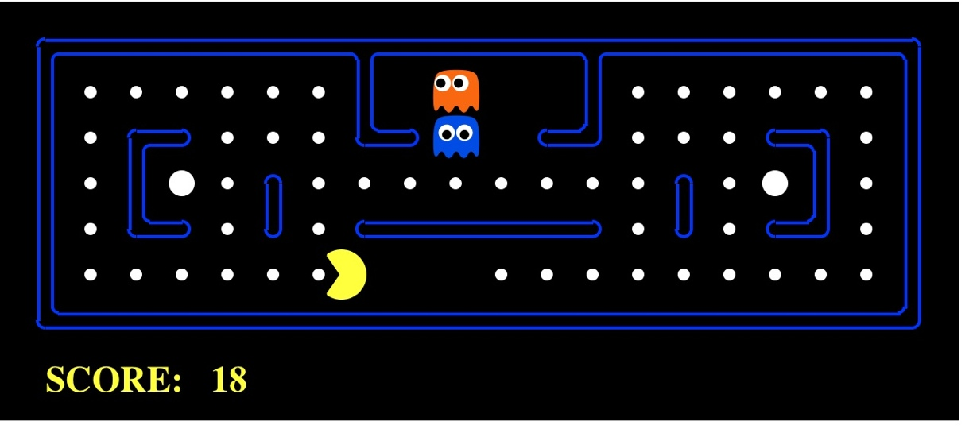
Pac-Man as an Agent
Agent
Environment
Sensors
Percepts
?
Actuators
Actions
Pac-Man is a registered trademark of Namco-Bandai Games, used here for educational purposes
Demo1: pacman-l1.mp4 or L1D2
Notes:
L1D2 =
python demos.py
Select Lecture 1 → select demo 2

Slide 24
Course Topics
Part I: Making Decisions
  Fast search / planning
  Constraint satisfaction
  Adversarial and uncertain search
Part II: Reasoning under Uncertainty
  Bayes’ nets
  Decision theory
  Neural networks, deep learning
  Machine learning
Part III: Miscellaneous applications
  Natural language, vision, robotics, games, …

